Slide 1
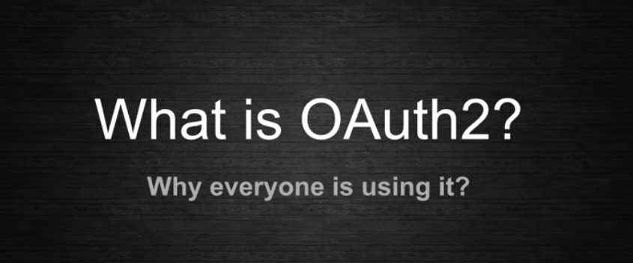
OAUTH2 - Introduction

Slide 2
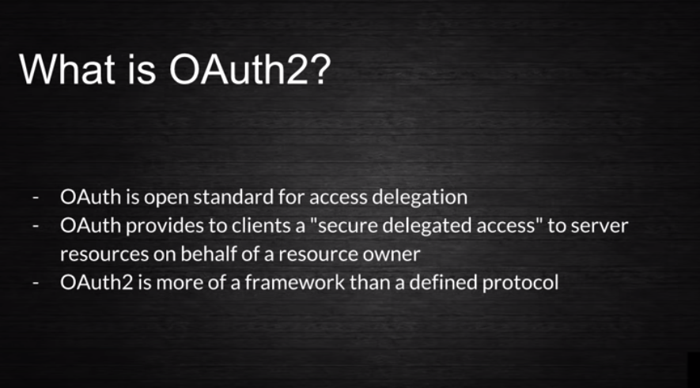
OAUTH2 - Introduction

Slide 3
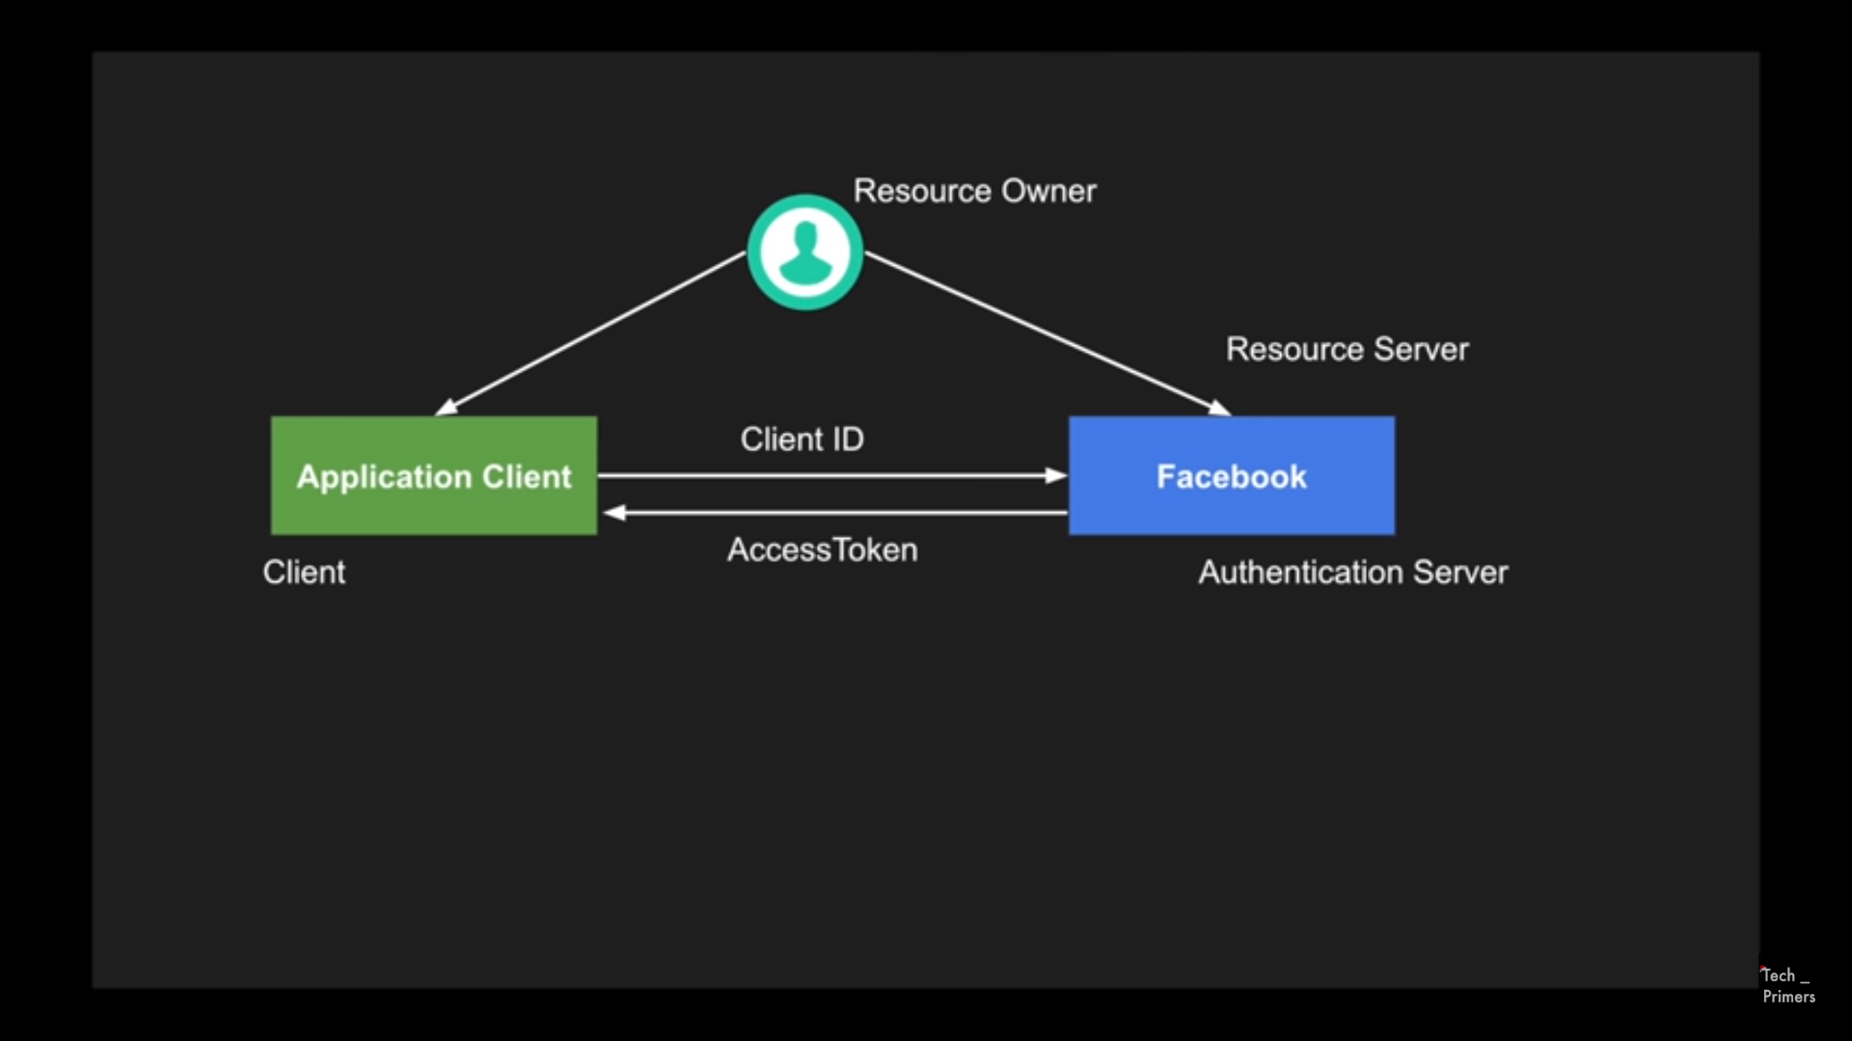

OAUTH2 - Introduction

Slide 4
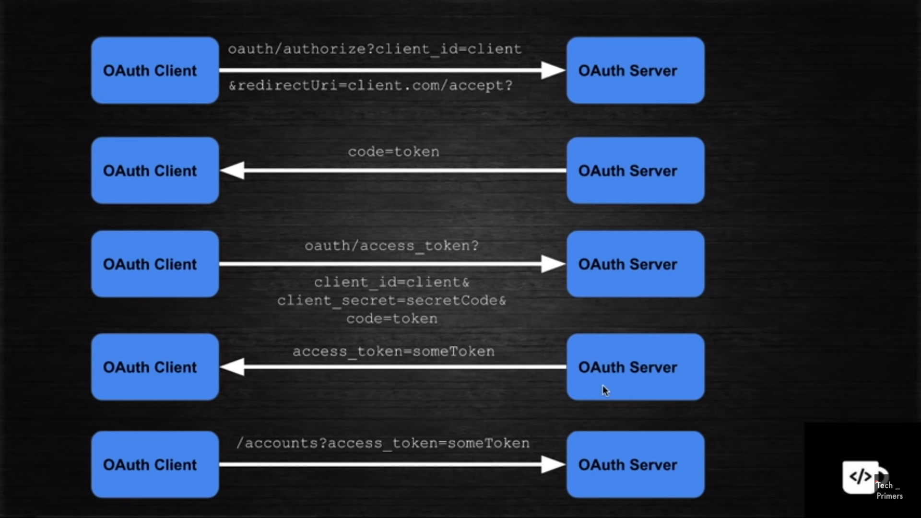

OAUTH2 - Introduction

Slide 5
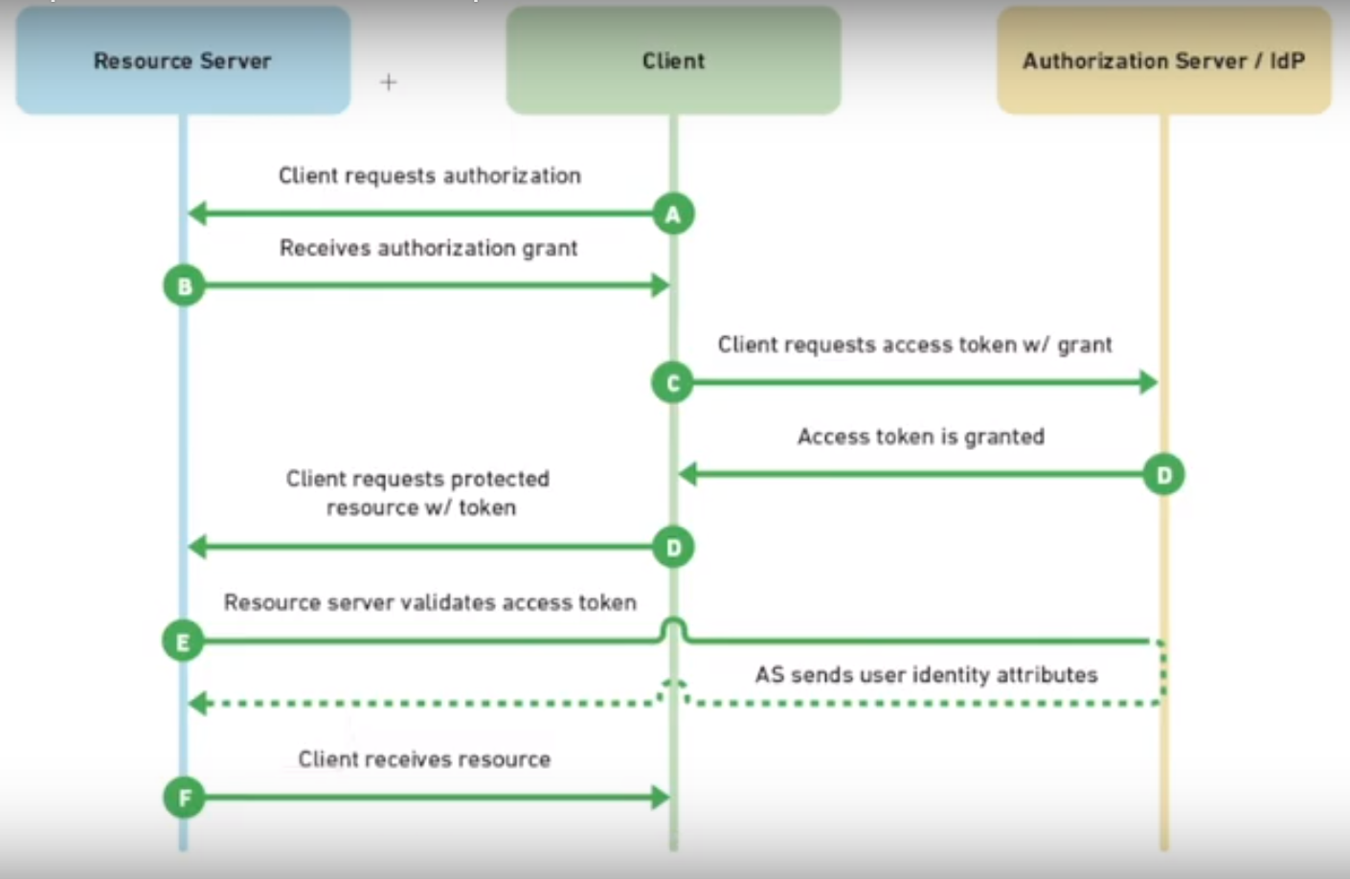
OAUTH2 - Introduction

Slide 6
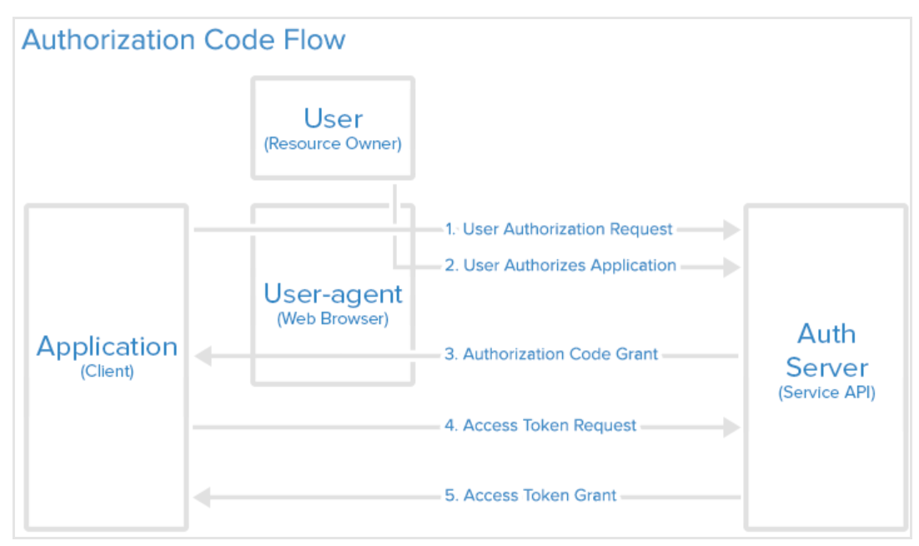
FLOW- DIAGRAM – OAUTH2

Slide 7
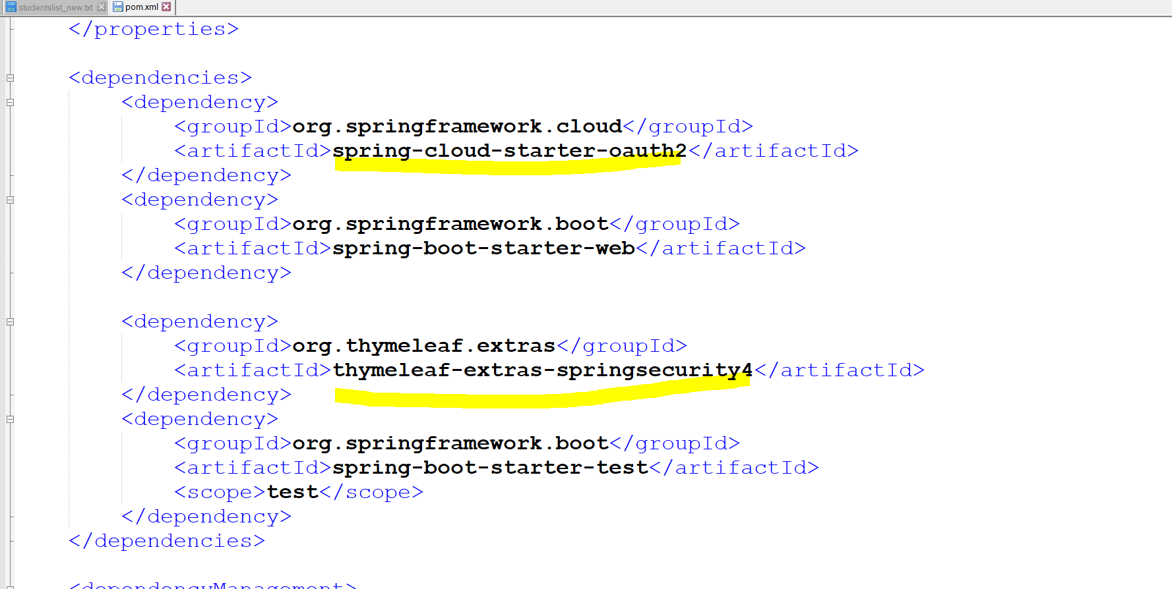
Spring Boot Security - oAuth

Slide 8
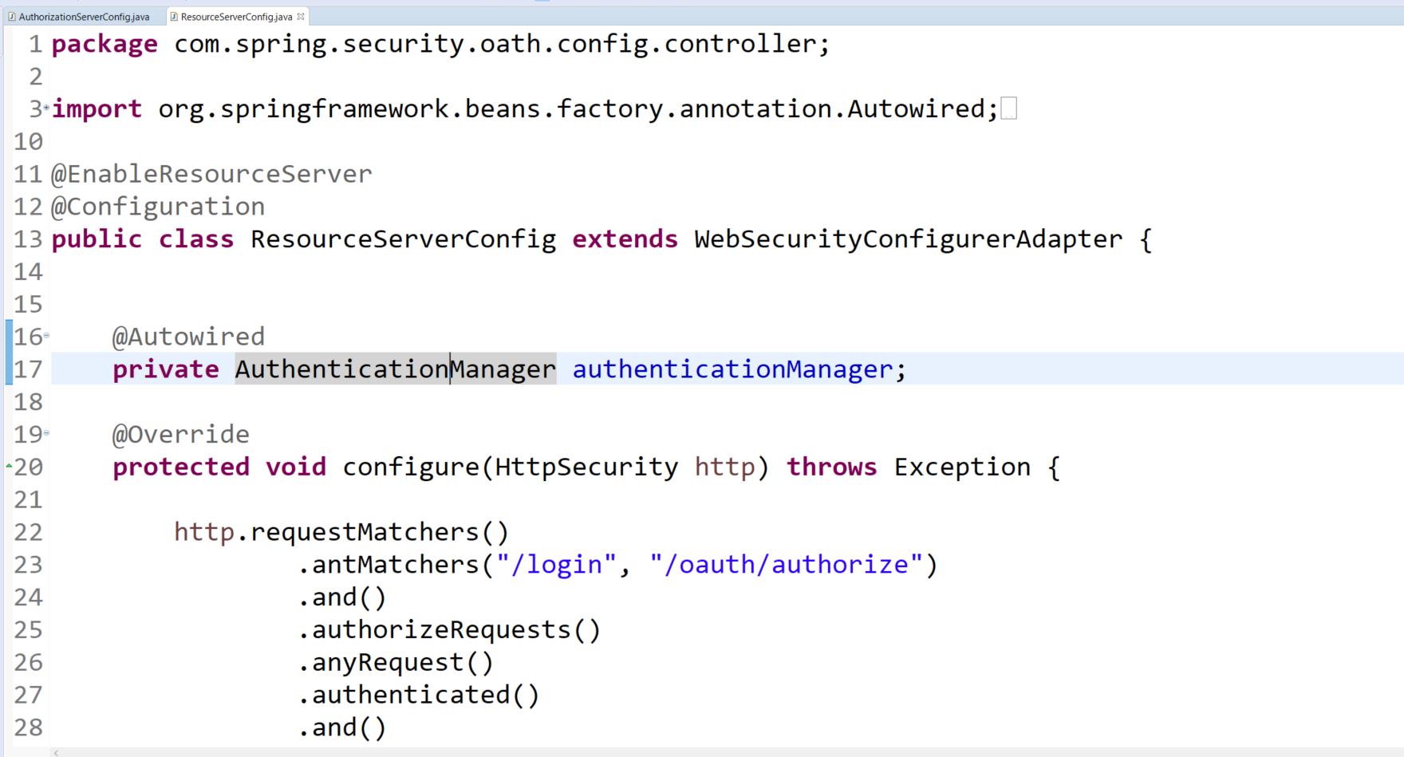
Spring Boot Security - oAuth

Slide 9
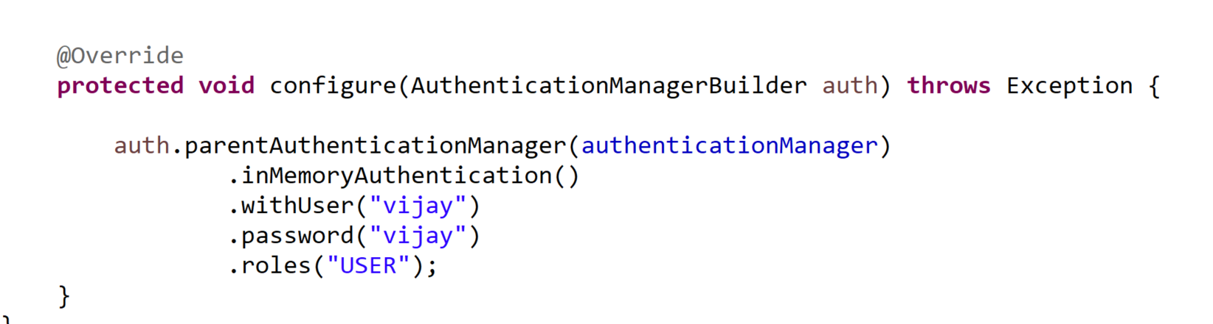
Spring Boot Security - oAuth

Slide 10
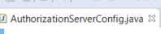
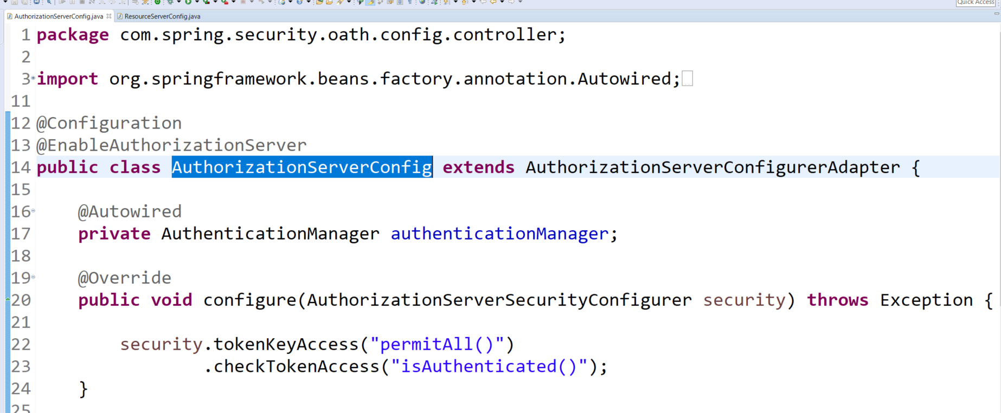
Spring Boot Security - oAuth

Slide 11
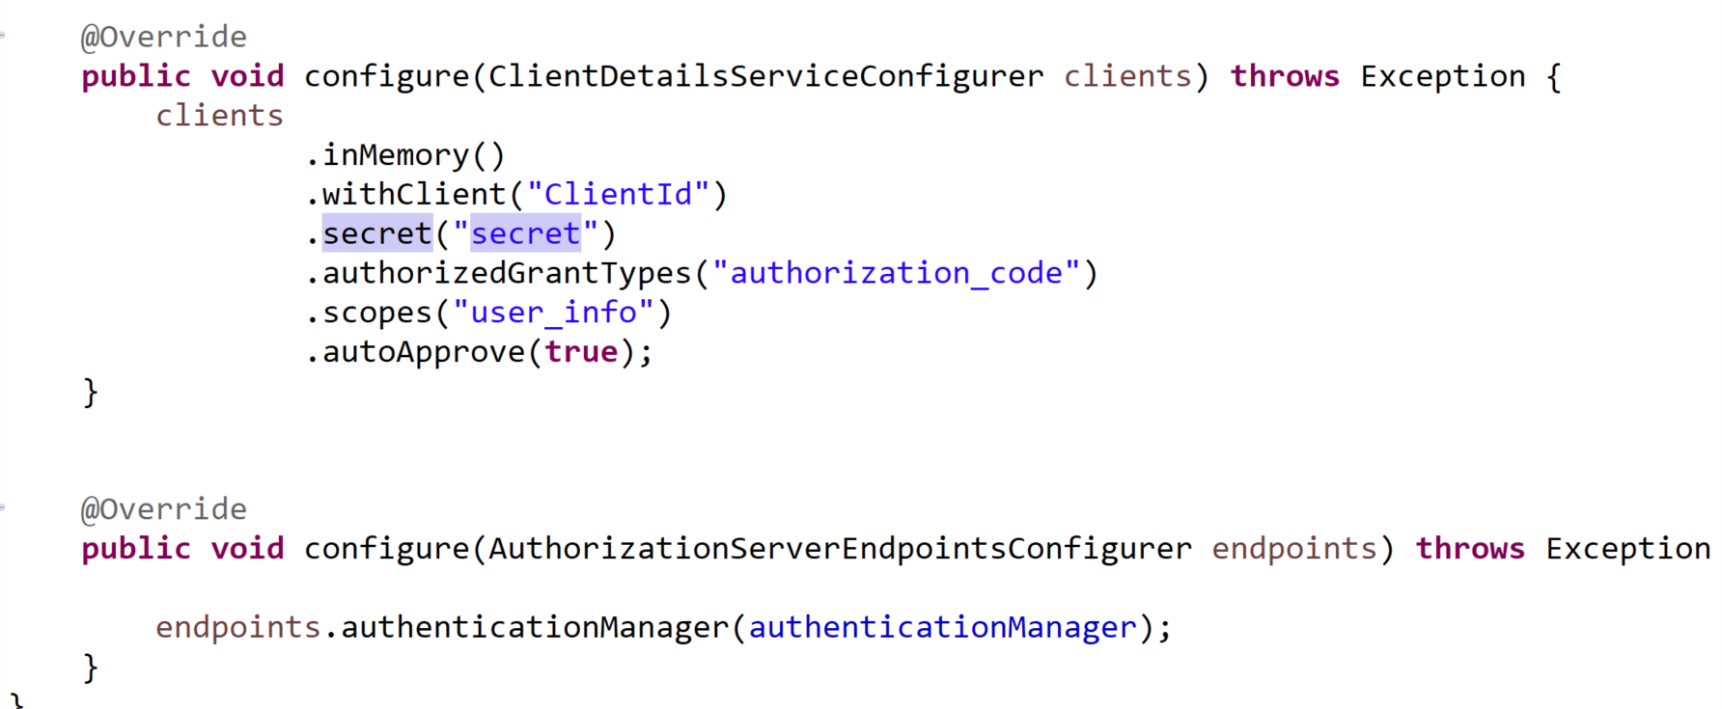
Spring Boot Security - oAuth

Slide 12
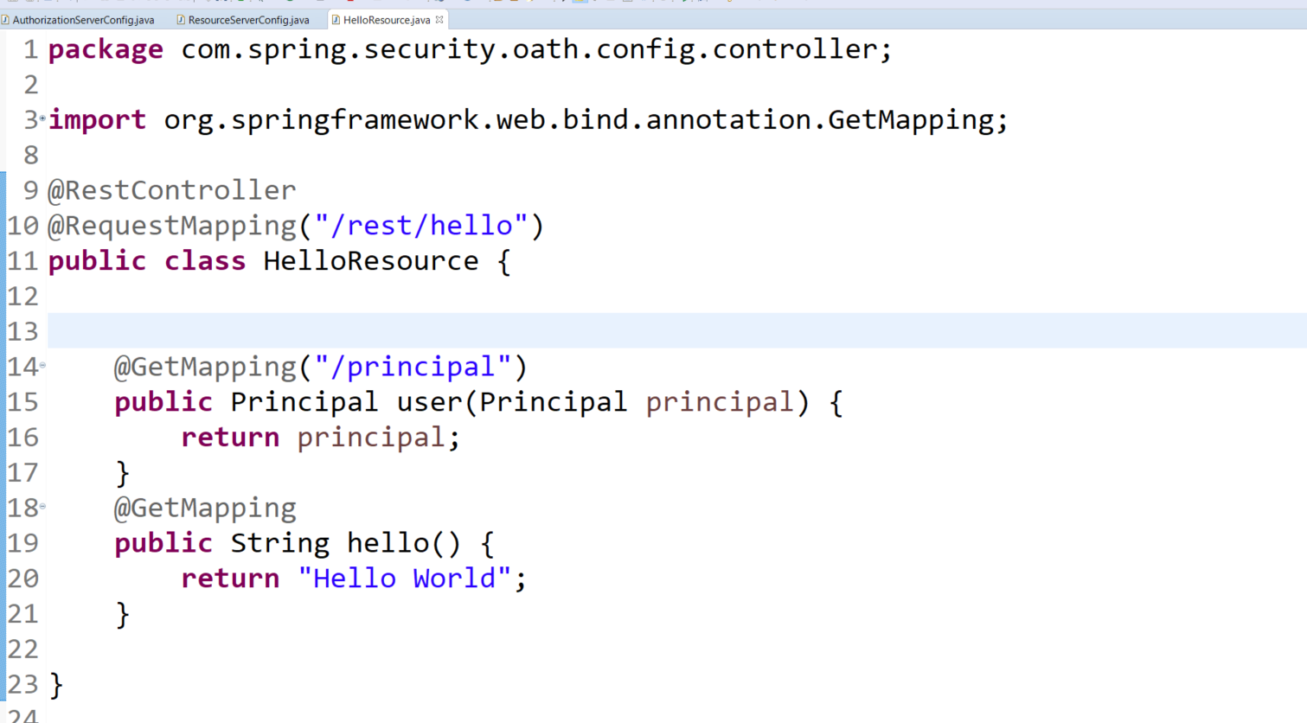
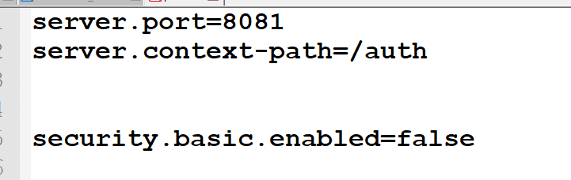
Spring Boot Security - oAuth

Slide 13
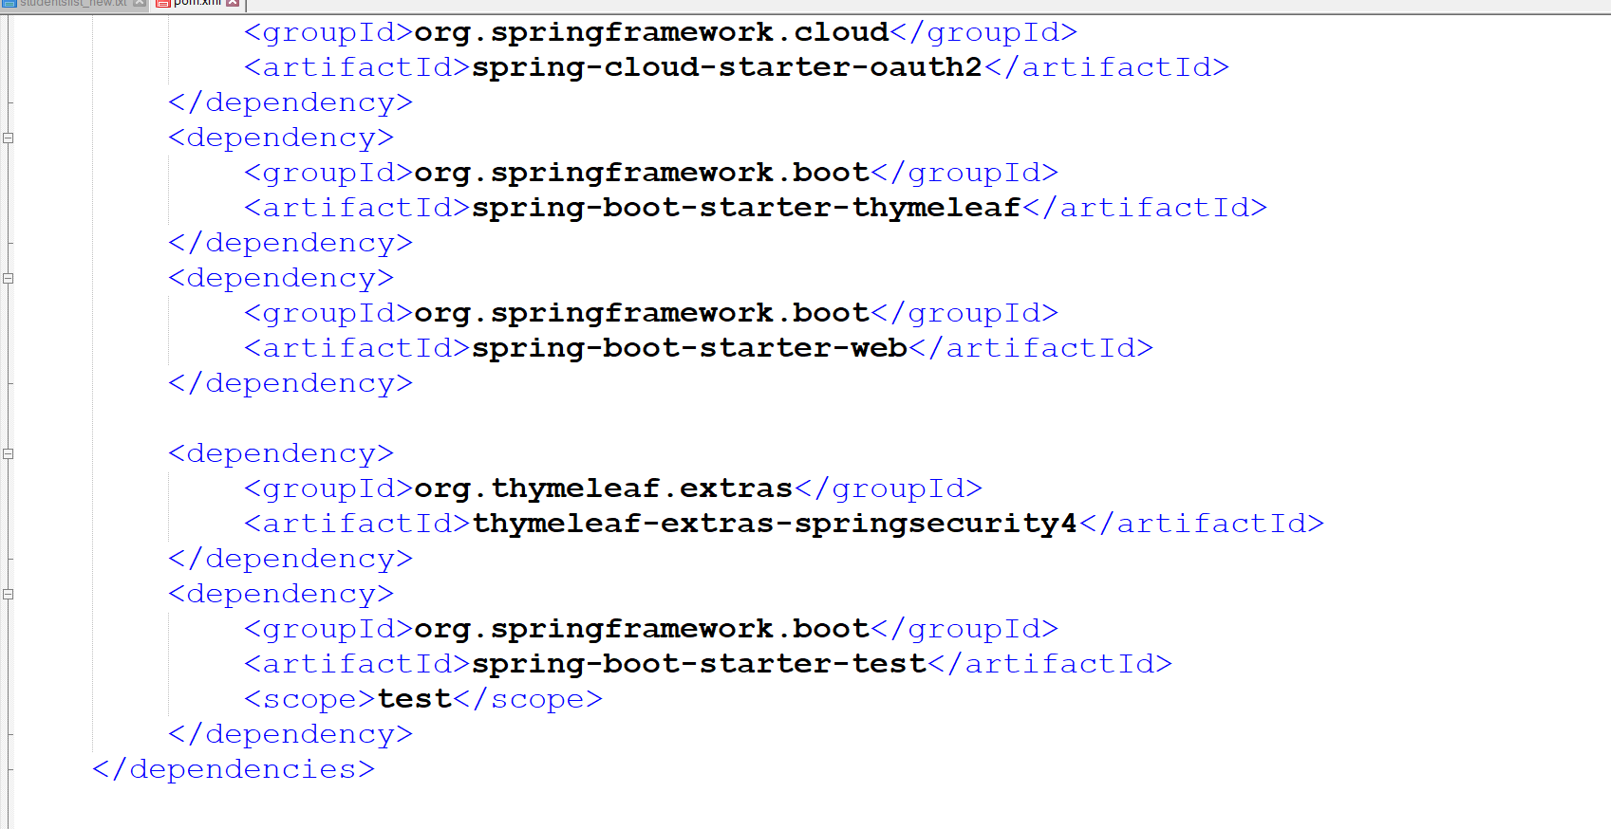
Spring Boot Security – oAuth - Client

Slide 14
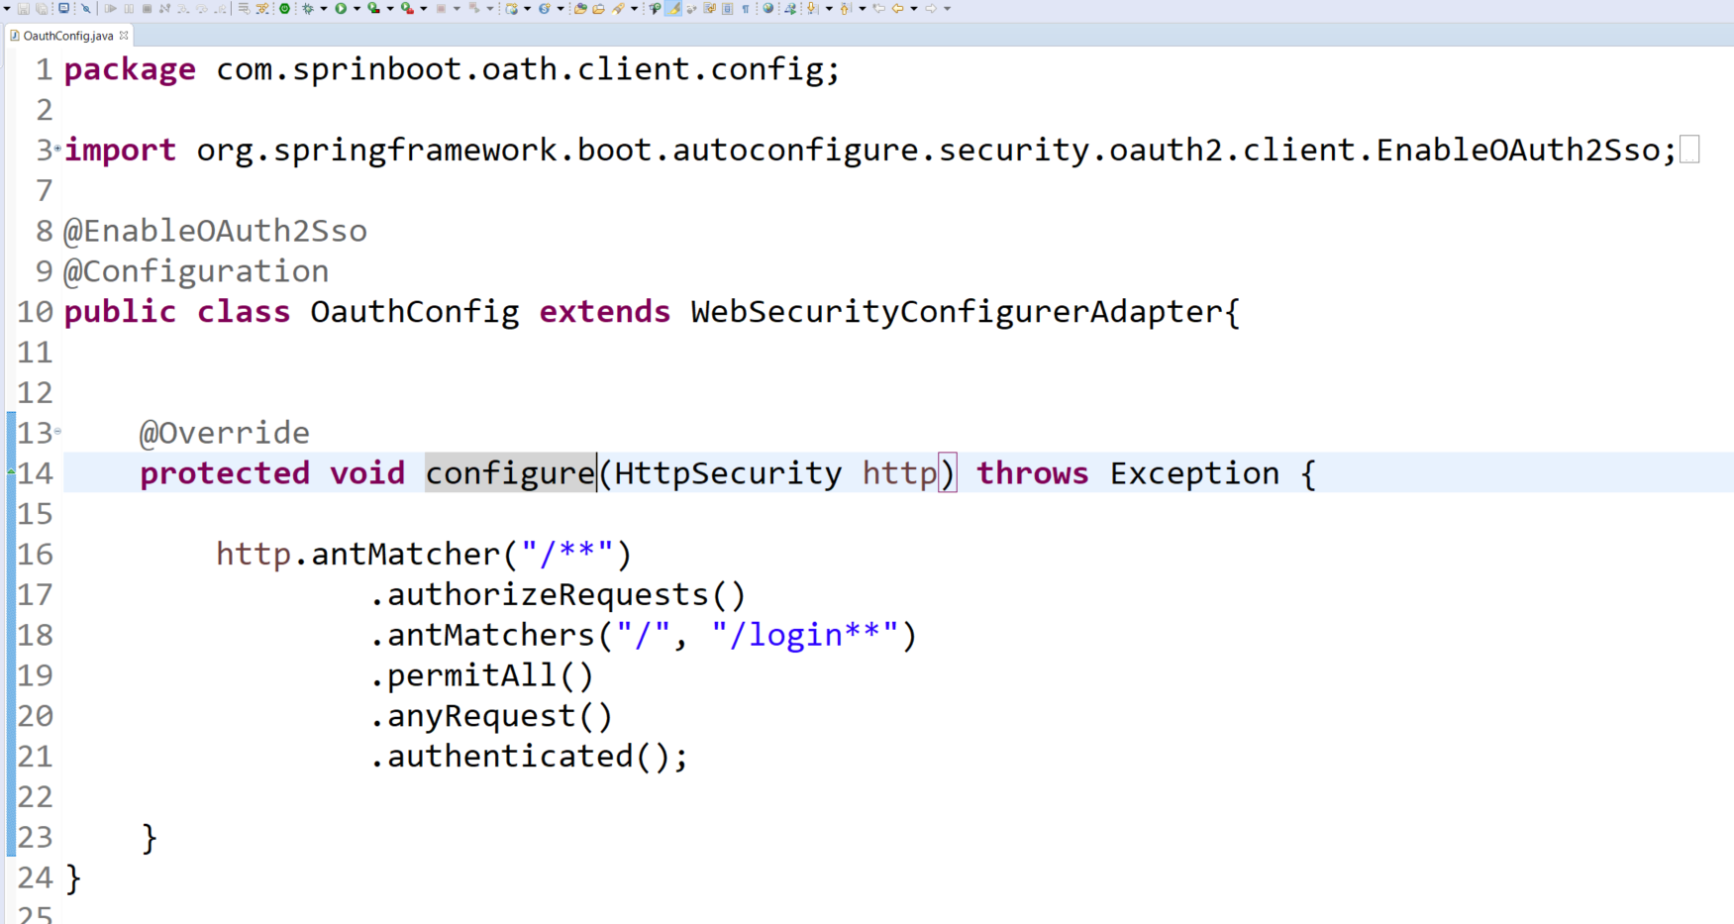
Spring Boot Security – oAuth - Client

Slide 15
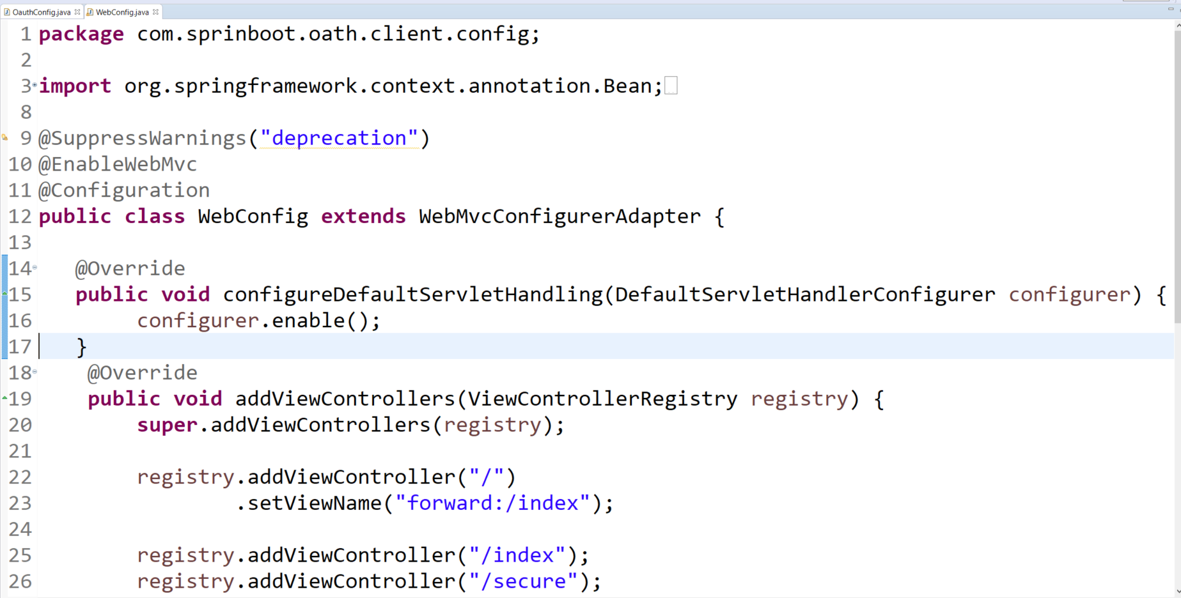
Spring Boot Security – oAuth - Client

Slide 16
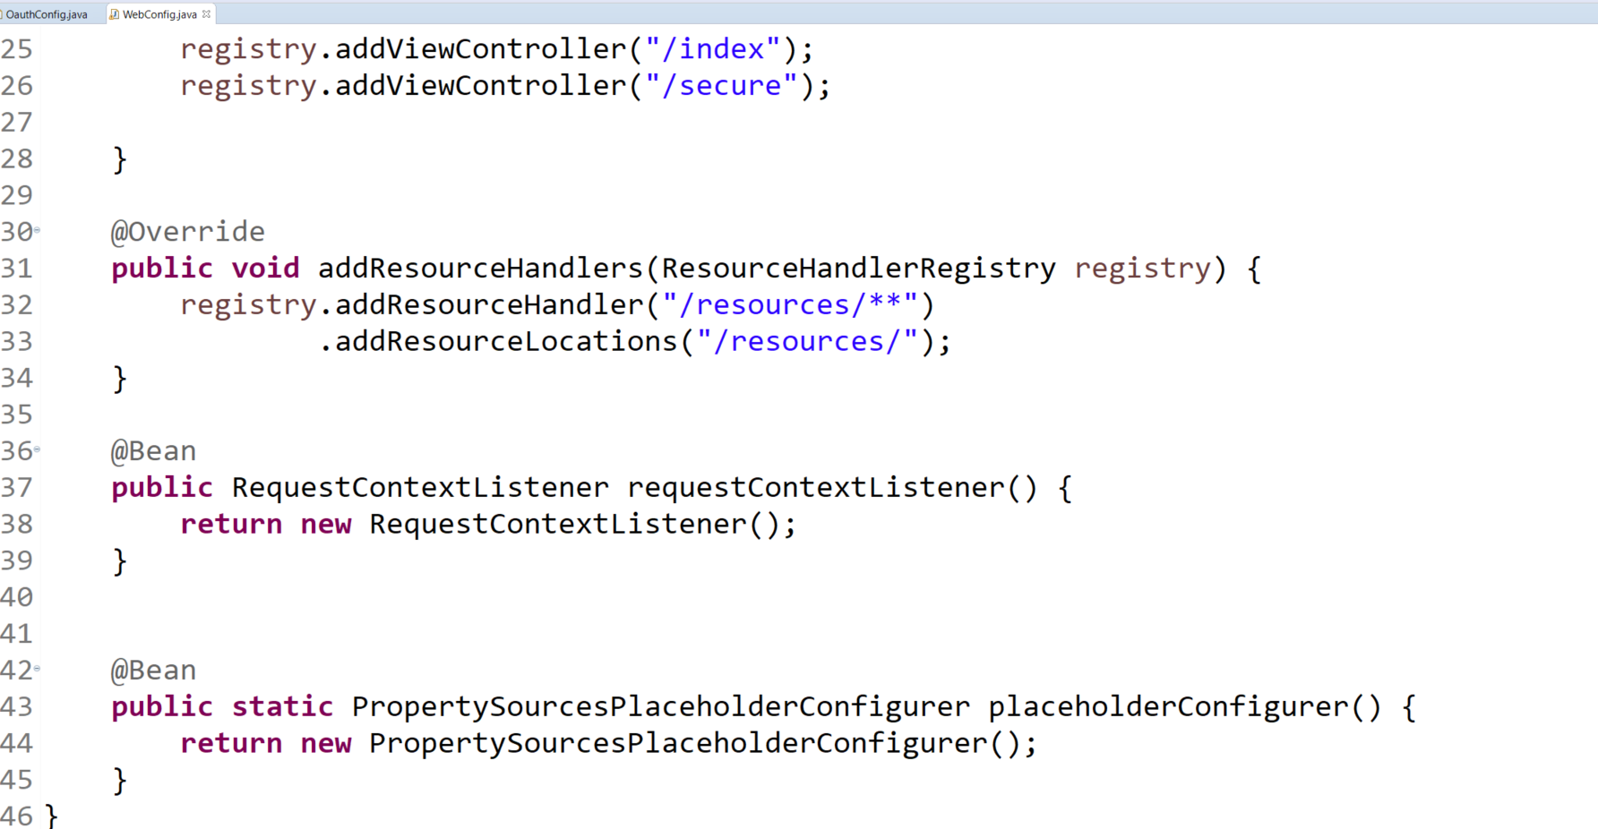
Spring Boot Security – oAuth - Client

Slide 17
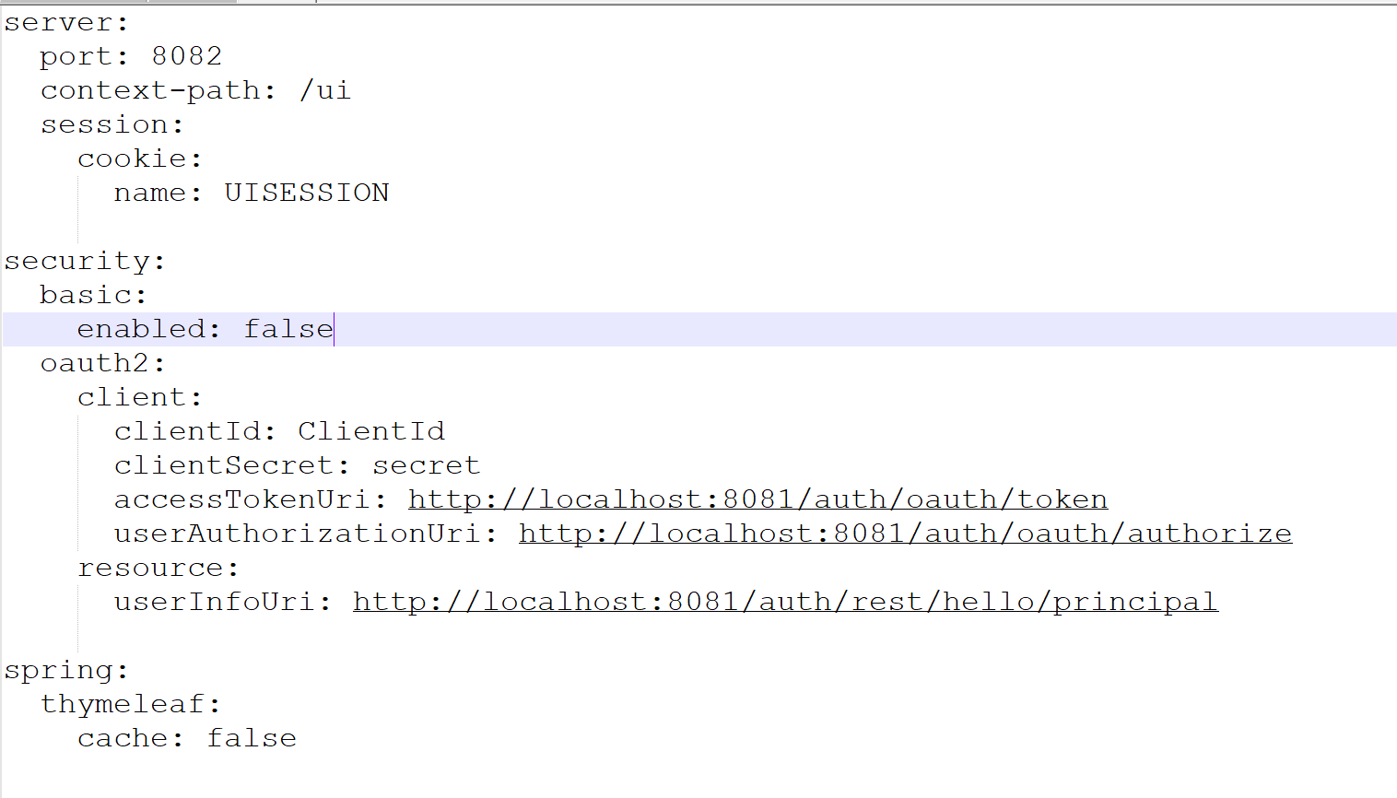
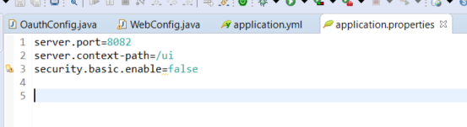
Spring Boot Security – oAuth - Client

Slide 18
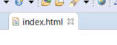
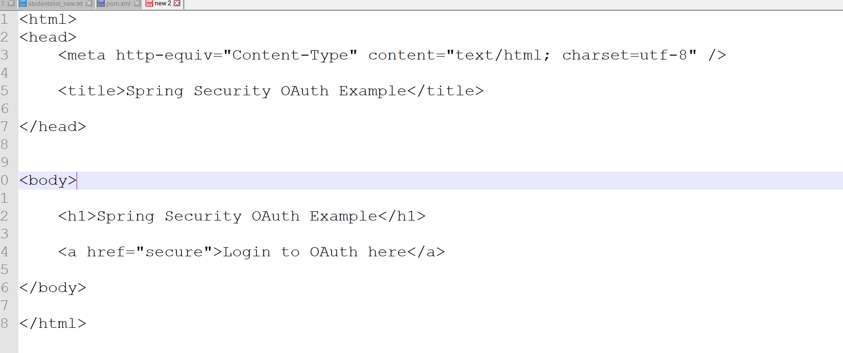
Spring Boot Security – oAuth - Client

Slide 19
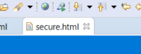
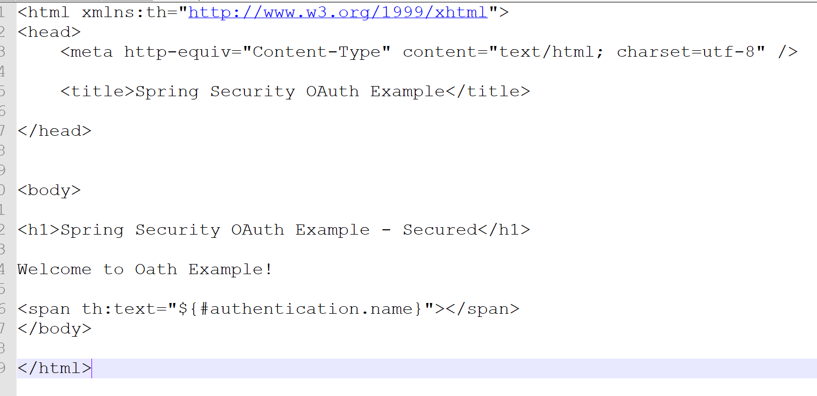
Spring Boot Security – oAuth - Client

Slide 20
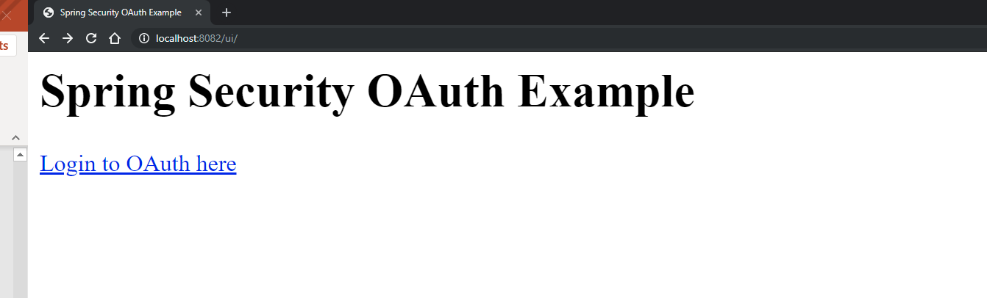
Spring Boot Security - oAuth

Slide 21
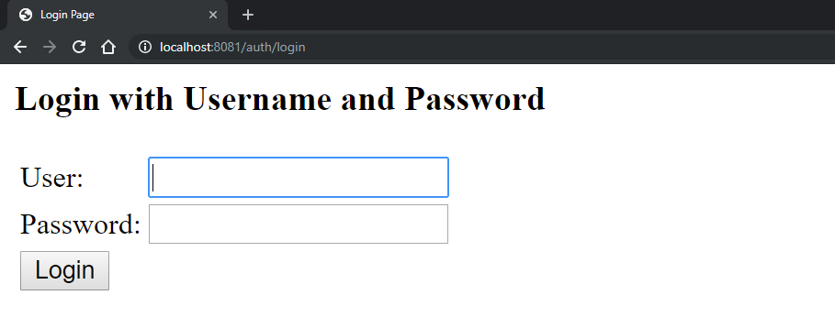
Spring Boot Security - oAuth

Slide 22
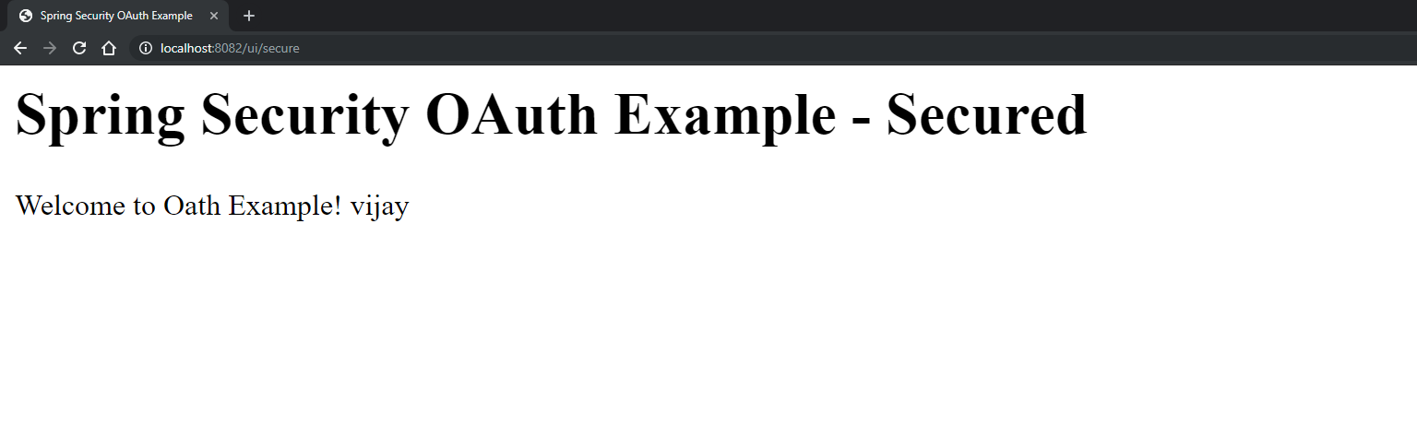
Spring Boot Security - oAuth

Slide 23
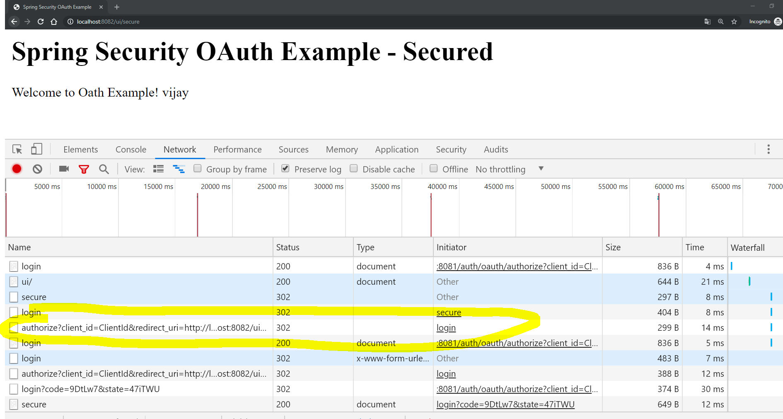
Spring Boot Security - oAuth

Slide 24
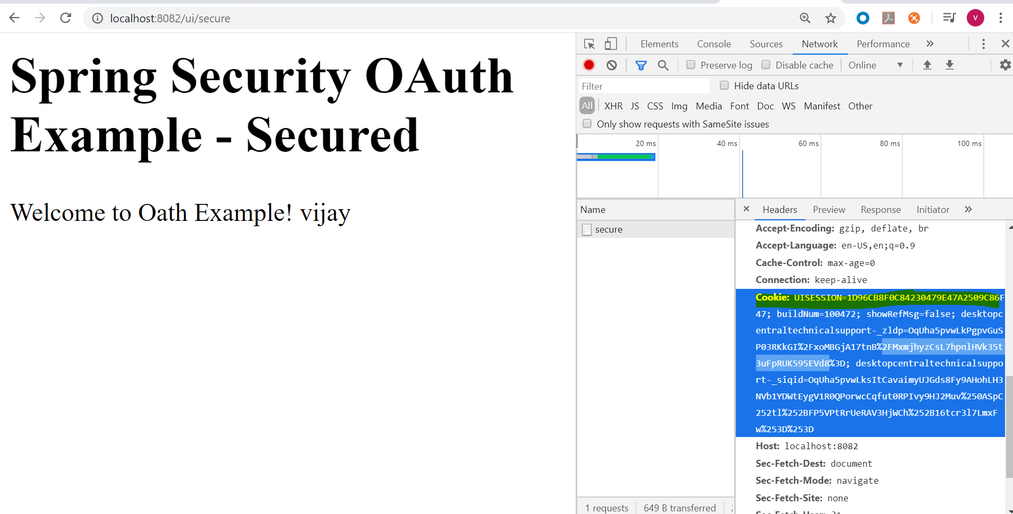
Spring Boot Security - oAuth

Slide 25
Eclipse projects
Server Code
Client code

Slide 26
Eclipse projects – Face book integration
Client code

